Slide 1
CampusBuzz AI-Driven Campus Information Assistant
Team Members:
Tejas Bahadur (RA2311003011820)
Ashmita Chakraborty (RA2311003011848)
Vansh Srivastava (RA2311003011846)

Slide 2
Introduction
CampusBuzz is an AI-driven chatbot designed to help students explore college clubs, events, and FAQs.
Provides instant answers to common queries using a friendly chat interface.
Built with a combination of Flask, MongoDB, LangChain, and Google's Gemini API.

Slide 3
Problem Statement
Students often struggle to find updated and structured information about college clubs, societies, and events.
There’s no centralized, interactive platform for resolving campus-related queries.
Static notice boards and web pages lack engagement and accessibility.

Slide 4
Objective
01
02
03
To build a user-friendly chatbot that:
Provides instant information about college clubs and FAQs.
Can be easily expanded to handle more queries.
Acts as a 24x7 virtual information desk for the campus.

Slide 5
Tech Stack
Frontend: HTML, CSS, JavaScript
Backend: Python Flask
Database: MongoDB
AI Integration: LangChain + Gemini

Slide 6
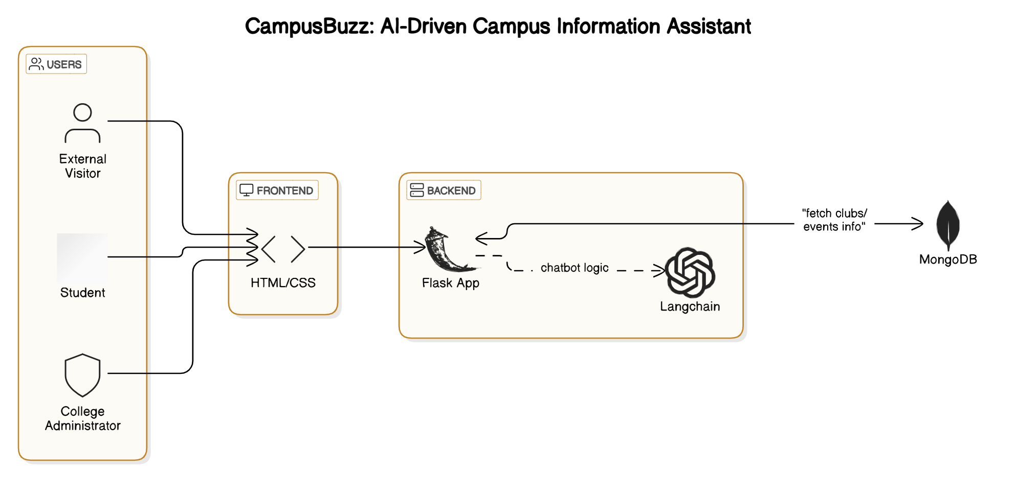
Architecture Diagram

Slide 7
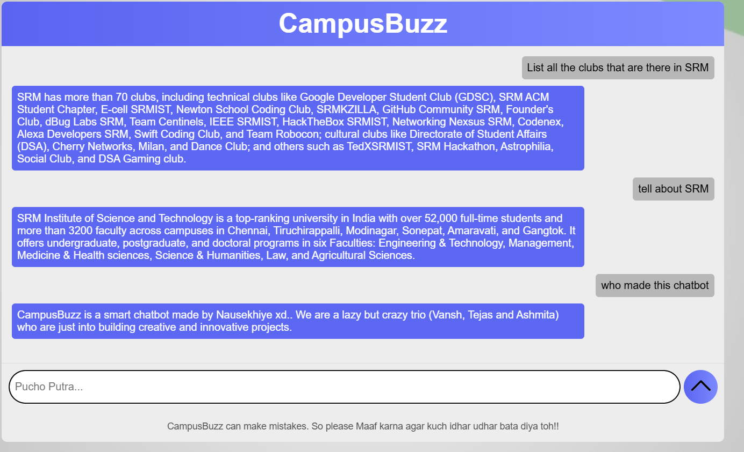
Demo

Slide 8
Source Code
from flask import Flask, request, jsonify
from flask_cors import CORS
import os
from dotenv import load_dotenv
from pymongo import MongoClient
from langchain_google_genai import ChatGoogleGenerativeAI
import google.generativeai as genai load_dotenv()
app = Flask(__name__)
CORS(app)
GEMINI_API_KEY = os.getenv("GEMINI_API_KEY")
genai.configure(api_key=GEMINI_API_KEY)
llm = ChatGoogleGenerativeAI(model="gemini-1.5-flash", google_api_key=GEMINI_API_KEY)
mongo_client = MongoClient("mongodb://localhost:27017")
db = mongo_client["CampusBuzz"]
clubs_collection = db["clubs"]
queries_collection = db["queries"] def get_all_clubs():
return [f"{club['club_name']}: {club['description']}" for club in clubs_collection.find()] def get_all_queries():
return [f"{q['question']}:{q['keywords']}: {q['answer']}" for q in queries_collection.find()] @app.route('/chat', methods=['POST'])
def chat():

Slide 9
Source Code
data = request.get_json()
query = data.get("message", "") if not query:
return jsonify({"response": "No message received."}) club_context = get_all_clubs()
faq_context = get_all_queries() if not club_context and not faq_context:
return jsonify({"response": "No data found in the system."})
context = f"""CLUB INFORMATION:\n{chr(10).join(club_context)}\n\nFREQUENTLY ASKED QUESTIONS:\n{chr(10).join(faq_context)}"""
prompt = f"""
You are a helpful campus assistant chatbot named CampusBuzz. Use the provided context to answer the user's query in a clear and concise way.
{context}
User Query: {query} Do not repeat the user question. Only respond with the helpful information from context.
"""
try:
response = llm.invoke(prompt)
return jsonify({"response": response.content if hasattr(response, "content") else str(response)})
except Exception as e:
return jsonify({"response": f"Error: {e}"}), 500
if __name__ == '__main__':
app.run(debug=True)

Slide 10
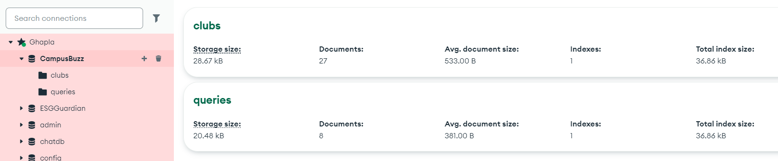
Dataset

Slide 11
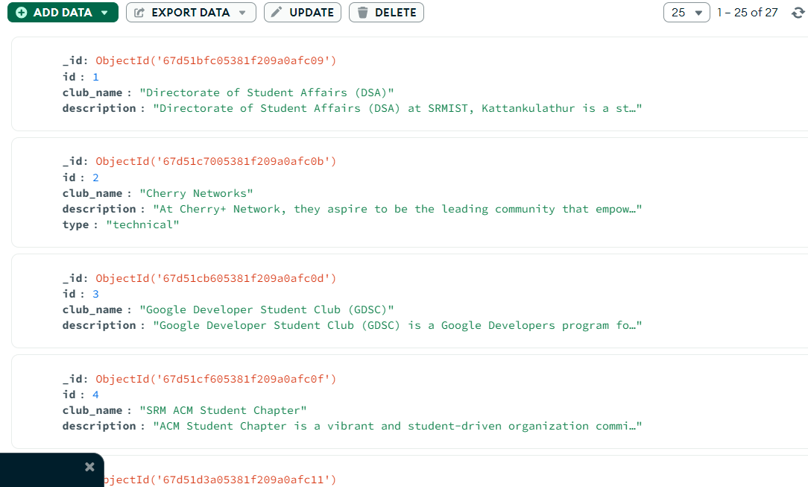
Dataset

Slide 12
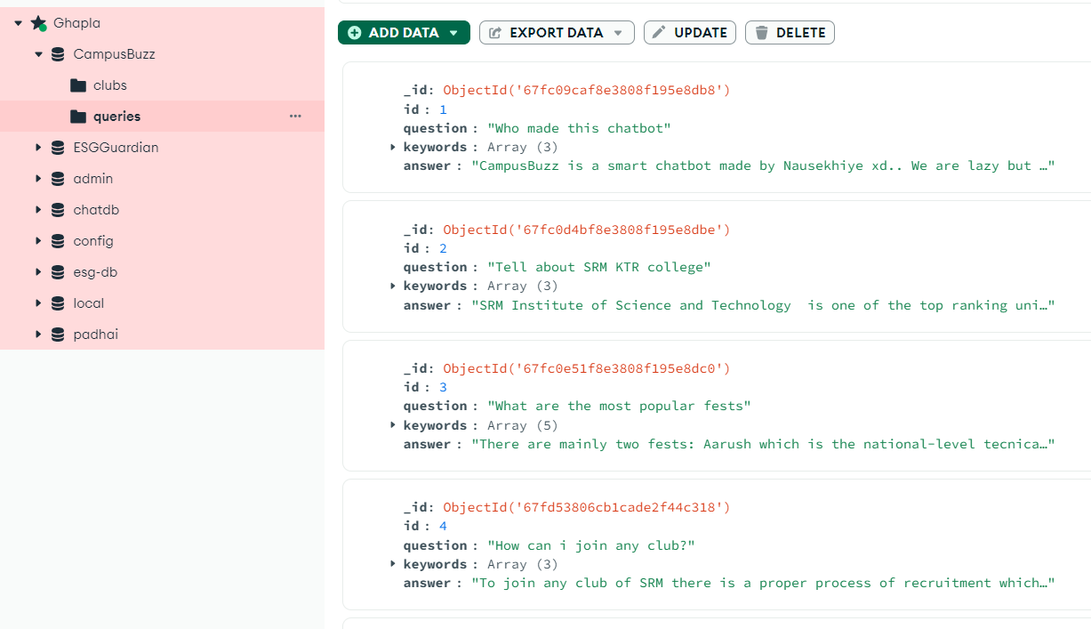
Dataset

Slide 13
Key Features
Club and society details retrieval.
Answering frequently asked questions.
Gemini-powered responses with LangChain context management.
Expandable database support (clubs, queries, about, etc.)

Slide 14
Conclusion
CampusBuzz helps reduce confusion and offers 24/7 virtual information desk.
Can grow with the campus – scalable and modular.
A step toward smarter campus support using AI.

